Slide 1

Conformity and Nonconformity

Slide 2
Conformity
Conformity: circumstances where we may act or think differently in our given situation than we would if we were alone
Different Forms of Conformity
Compliance
Obedience
Acceptance

Slide 3

Why Do We Conform?
Normative Conformity
Informational Conformity

Slide 4

Classic Social Psychological Studies of Conformity
Sherif
Asch
Milgram

Slide 5


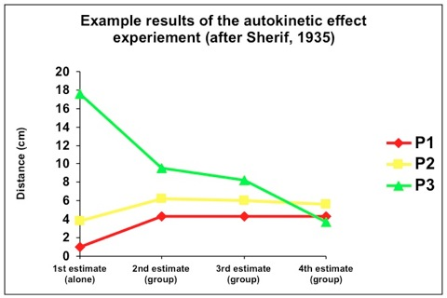
Sherif and the Auto-Kinetic Experiments
Muzafer Sherif – 1935
How are Social Norms formed?

Slide 6
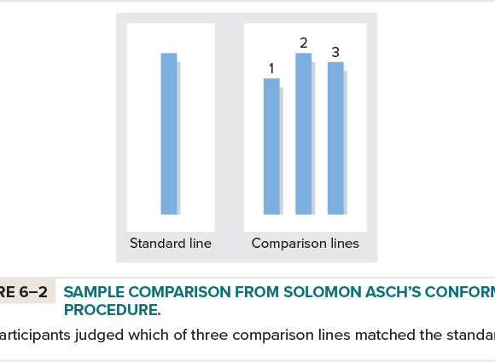
Asch’s Conformity Experiments
Soloman Asch – 1950’s
How are our Opinions Shaped by those around us?

Slide 7

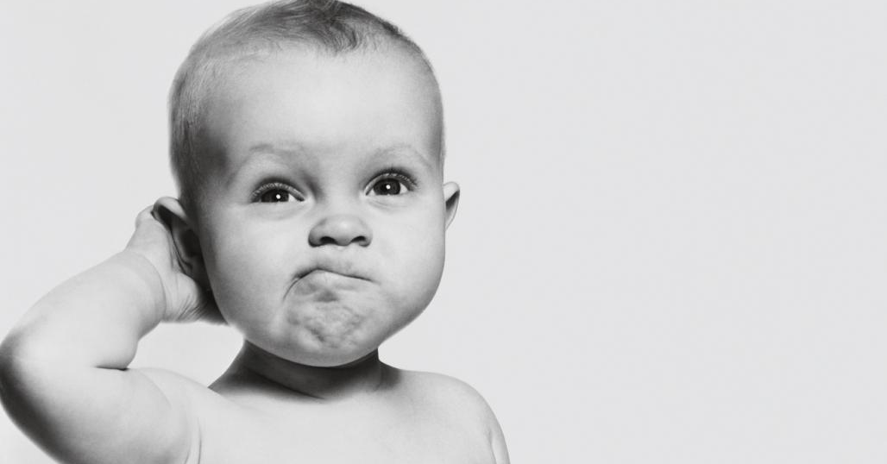

What is Deviance?

Slide 8
Anomie Theory
Merton
People are Guided by Culturally Appropriate Goals and Means
Strain occurs when these goals/means cannot be attained

Slide 9
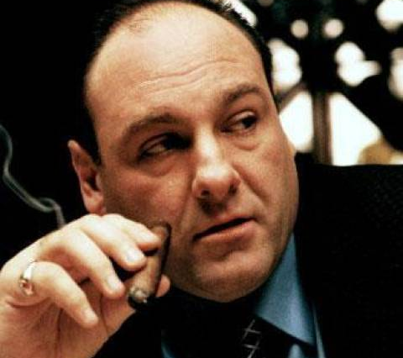
Innovation
Accept the Goals – Reject the Means

Slide 10
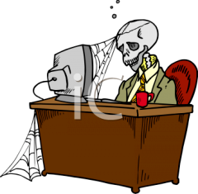
Ritualism
Reject the Goals – Accept the Means

Slide 11
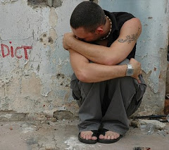
Retreatism
Reject the Goals – Reject the Means

Slide 12
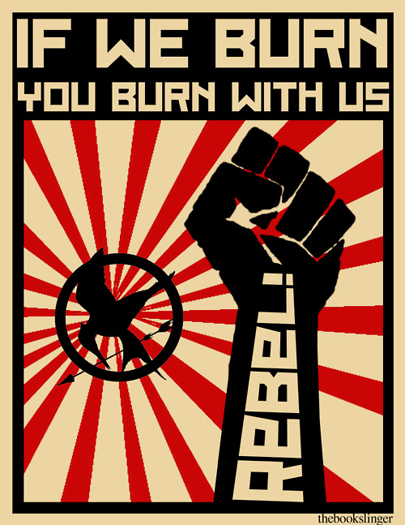
Rebellion
Rejects Goals and Means – Seeks to Replace them with Other Goals and Means

Slide 13
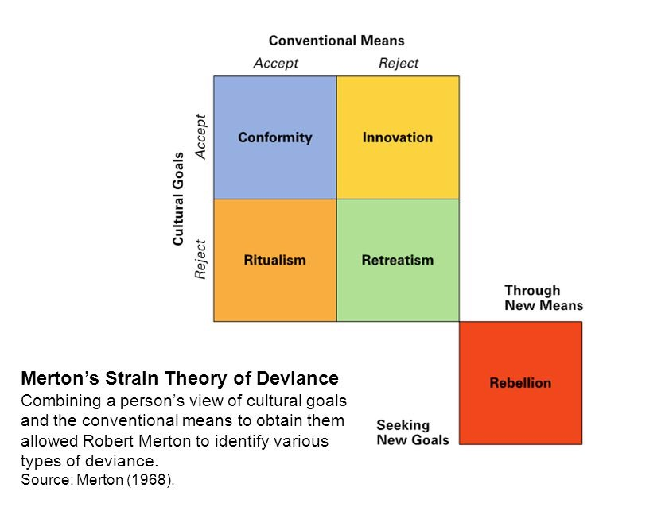

Slide 14
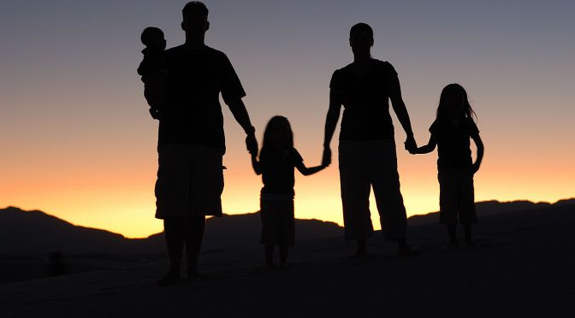
Control Theory
Social Control Keeps Us in Line
Strength of our Social Ties

Slide 15
Social Bonds Theory
Hirschi
Our Bonds Impact our Likelihood to be Deviant
4 Components
Attachment
Commitment
Involvement
Belief

Slide 16
Differential Association Theory
Sutherland
Learning Theory
Learn Criminal Behaviour from our Primary Groups
Classical Conditioning

Slide 17

Differential Identification Theory
Glaser Building off the Gaps in Sutherland’s Work
We Can Learn from Non-Significant Others
Example of Slender Man

Slide 18

Labelling Theory
Grounded in Symbolic Interactionism
Becker
Focus is on Reactions to ‘Deviance’
Eye of the Beholder
Emphasis on Rule Breaking, not Norm Violations

Slide 19
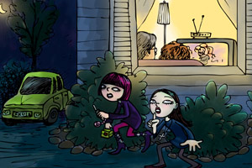
Primary and Secondary Deviance
Primary Deviance
The initial act
Secondary Deviance
Internalization of deviant identity

Slide 20
Techniques of Neutralization
Denial of Responsibility
Denial of Injury
Denial of Victim
Condemning the Condemners
Appeal to a Higher Loyalty

Slide 21

Reactions to Deviant Behaviour

Slide 22

Informal Labelling
Informal Rules Broken
Informal Social Control

Slide 23
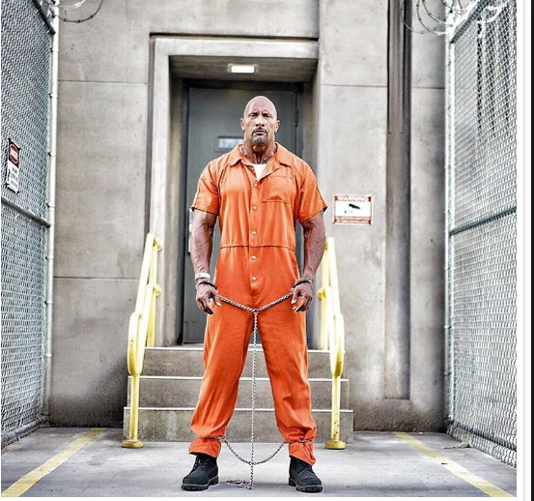
Formal Labelling
Label Placed by Institution, Social Service
Documented
Formal Social Control

Slide 24
Societal Benefits of Formal Labelling
Point of Reference
Scapegoat to Release Tension
Sense of Community and Solidarity

Slide 25
Formal Labelling Pros and Cons: The Case of ‘Problem’ Children
Children Diagnosed with Learning, Behavioural, and/or Emotional Problems
Benefits:
Get Help

Slide 26
Formal Labelling Pros and Cons: The Case of ‘Problem’ Children
Consequences:
Only seeing the label
All or nothing
Self-fulfilling prophecies and stigma
Over-medicating

Slide 27

Have a Great Day!

